Slide 1


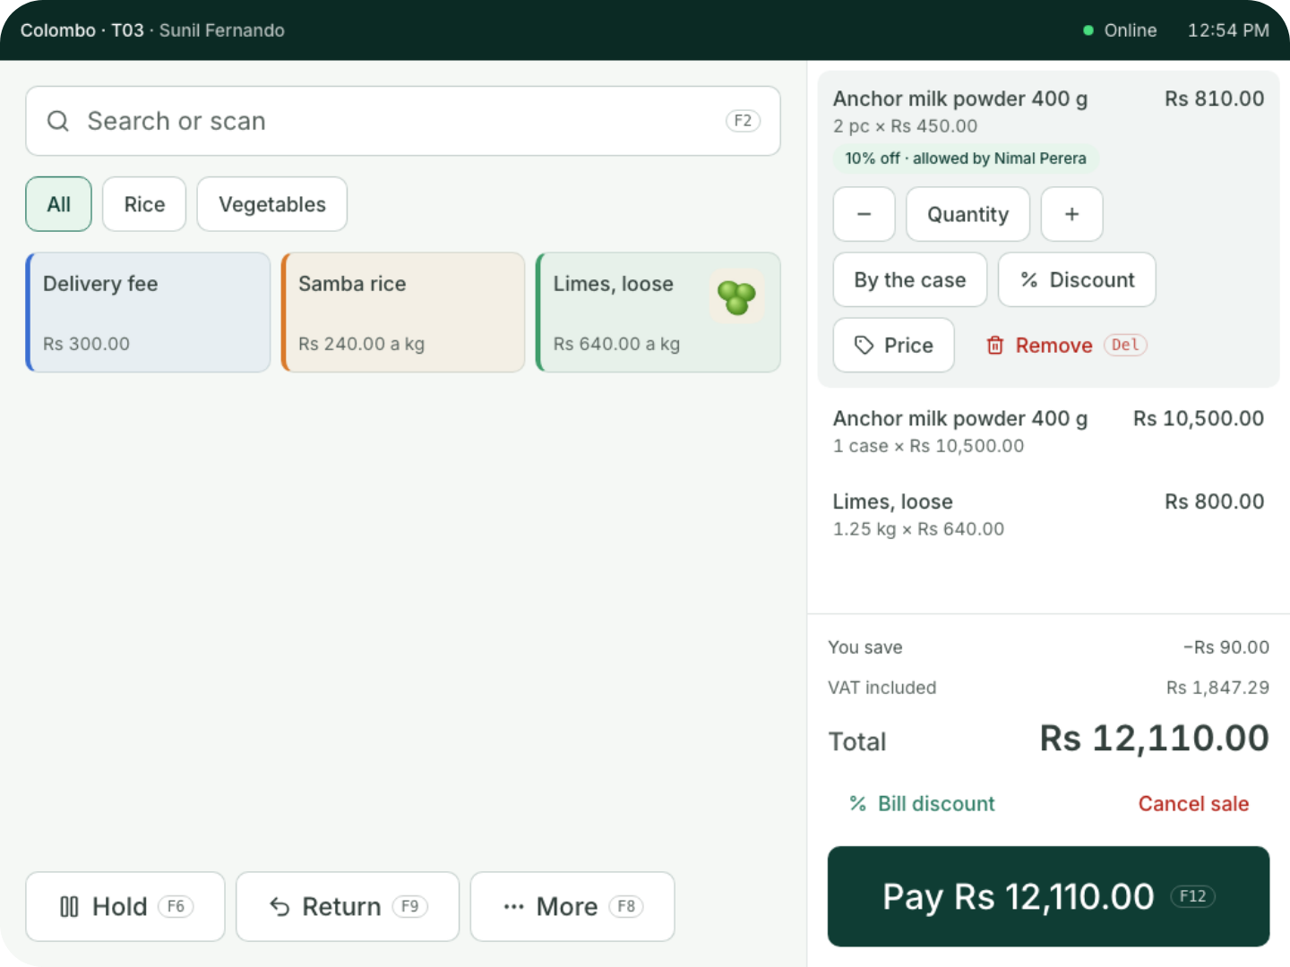
For shops and supermarkets
You sell.
Coredile does the
rest.
Barcodes, printed prices, stock in every branch, suppliers and
customers on credit, in one system that keeps billing when the
internet drops.
Notes:
Thank you for your time today. I’m going to show you Coredile POS for shops and supermarkets. It’s a billing system, but it does much more than print a bill: it keeps your stock, orders from your suppliers, looks after customers who pay later, and shows you where your money goes. Please stop me and ask questions at any time.

Slide 2




THE USUAL WAY
Most tills stop at the bill.
The customer leaves. Then the real work starts.
Counting stock by
hand on Sundays
Finding out too
late that something
ran out
A notebook for
customers who
pay later
Guessing which
items really make
money
Coredile does all of this for you, with every bill.
Notes:
Most tills only print the bill. After that, the owner still does a lot of work by hand. Someone counts the stock on a Sunday. Nobody notices an item has run out until a customer asks for it. Customers who pay at the end of the month are written in a notebook. And most owners are not sure which items really make them money. Ask them: which of these do you do today? Coredile takes these jobs away.

Slide 3





THE BIG IDEA
One bill. Five jobs done for you.
Stock
Milk powder, rice and limes come off
Bill 142
Paid by card
Reorder
2 × Anchor 400 g
900
Milk powder is low: on the order list
5 kg Samba rice
1,200
Profit
0.5 kg Limes
320
What you made, at what you paid for it
Accounts
Total
Rs 2,420
Sale, VAT and card money written in
Morning email
Part of yesterday’s figures, sent at 7 a.m.
Notes:
This is the heart of Coredile. The cashier does one thing: ring up the bill. Then Coredile does five jobs by itself. The milk powder, rice and limes come off the stock. If milk powder is now low, it goes on the list of what to order. It works out what you made on the bill, at what you actually paid for the goods. It writes the sale, the VAT and the card money into the accounts. And tomorrow at 7 in the morning, the owner gets an email with yesterday’s figures. Nobody types anything twice. (In Present mode, each job appears one by one as you click.)

Slide 4
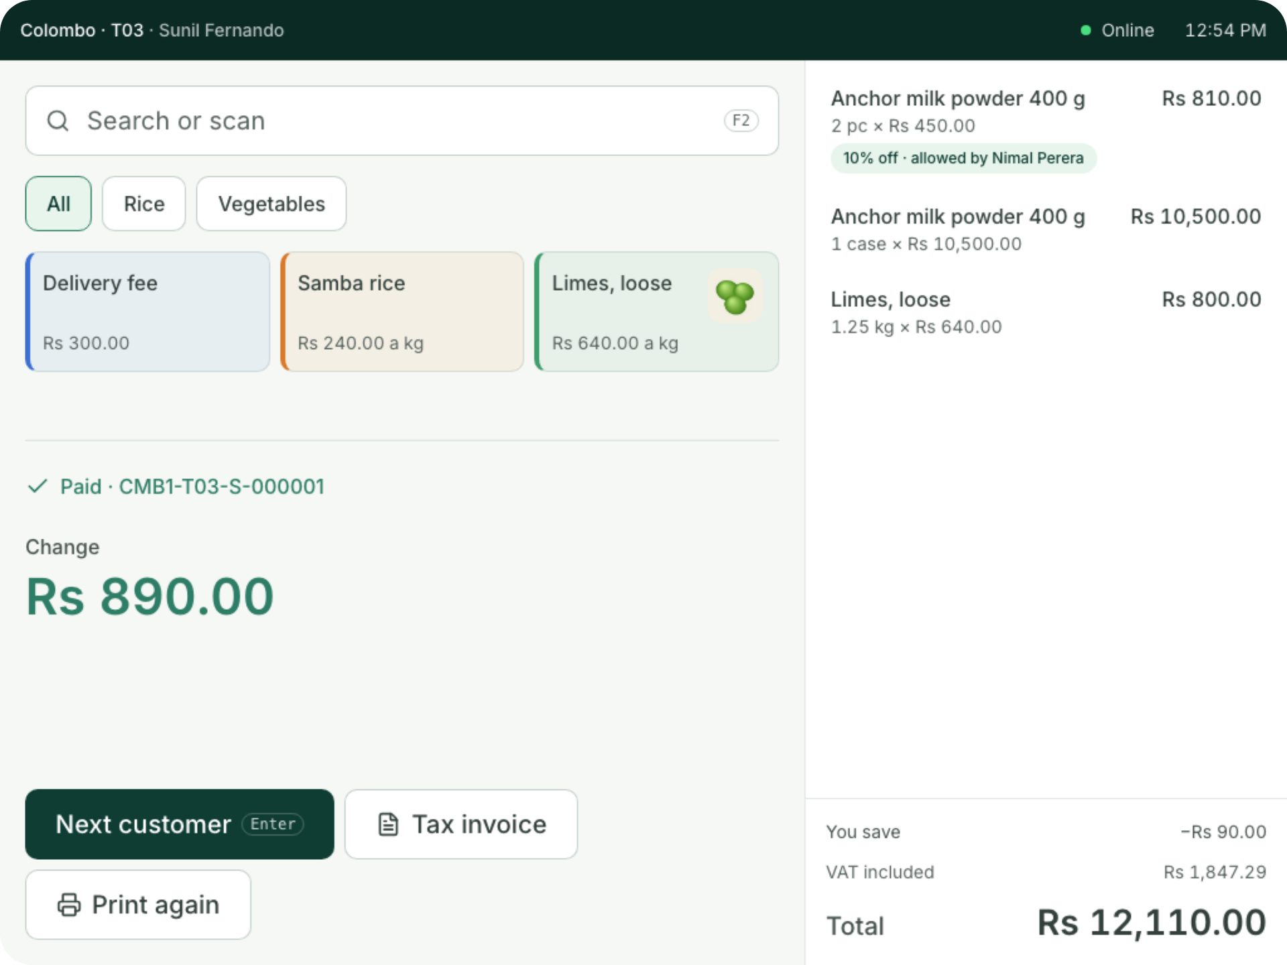

AT THE COUNTER
Easy to learn.
Quick to use.
Scan a barcode, or tap a quick button
Sell by the piece or by the case
Cash, card, bank transfer or QR
Hold a bill and serve the next customer
A tax invoice when a business asks for one
Notes:
This is the real till screen. Big buttons, clear prices, and the total always on the right. A new cashier learns it in one shift. They scan the barcode or tap a quick button, and can sell by the piece or by the whole case. Customers pay by cash, card, bank transfer or QR, and the till shows the change. If a customer forgets something, the cashier holds the bill and serves the next person. And when a business customer asks for a tax invoice, it’s one button. Big discounts and refunds need a manager’s PIN, so nothing happens without the owner knowing.

Slide 5
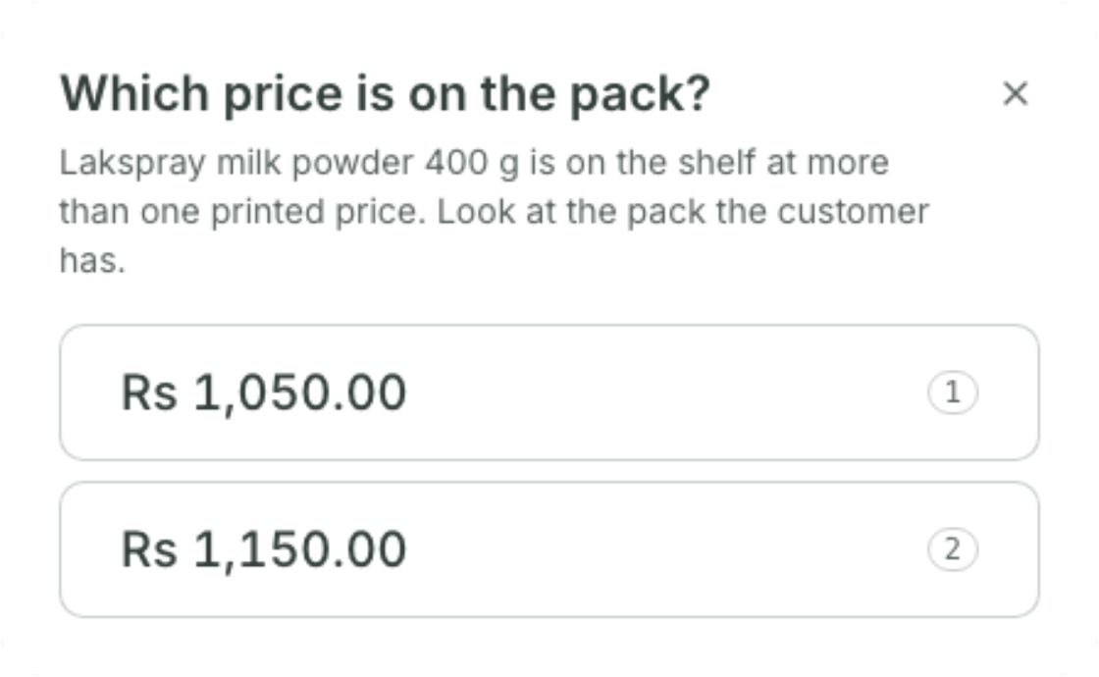
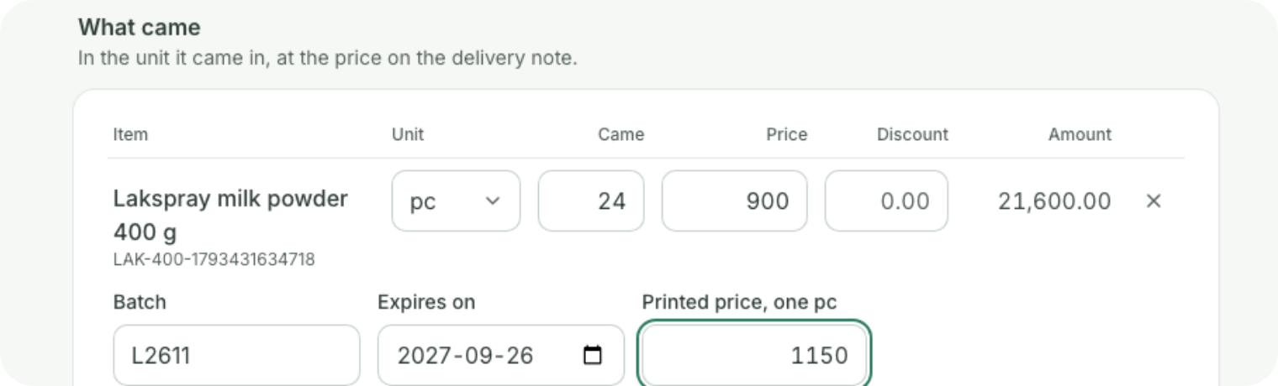
PRINTED PRICES
The price on the pack, every time.
Old stock and new stock often carry different printed prices.
When goods arrive, you type in each batch’s printed price,
with its expiry date.
At the till, Coredile asks which price is on the pack, and sells
that batch at that price.
It works with the internet down too.
Notes:
In Sri Lanka, most packs carry a printed price, and when prices go up, old and new stock sit on the shelf side by side with different prices. With Coredile, when the goods arrive you type in each batch’s printed price and expiry date. At the till, if there are two prices on the shelf, Coredile asks the cashier which one is on the pack, and sells that batch at that price. If there’s only one, it asks nothing. And it works without the internet too.

Slide 6
WHEN THE INTERNET DROPS
No internet? Keep billing.
Each till keeps its own copy of your products, prices and staff. It does not need the internet to sell.
1
2
3
Internet off
Keep selling
Internet back
The till carries on as if nothing
happened.
Bills print as normal. Your
customers never notice.
Every bill goes up by itself, in
order. Nothing is lost.
Up to 3 days without internet. At closing, the till tells you if the cash is short or over.
Notes:
Power cuts and internet problems happen. With most online systems, billing stops and the queue gets longer. Coredile is different. Each till has its own copy of everything it needs. When the internet goes, the cashier keeps billing and printing as normal. When it comes back, every bill is sent up by itself, in the right order. Nothing is lost. A till can work for up to 3 days without internet. And at closing, the cashier counts the cash and the till shows straight away if anything is short or over.

Slide 7
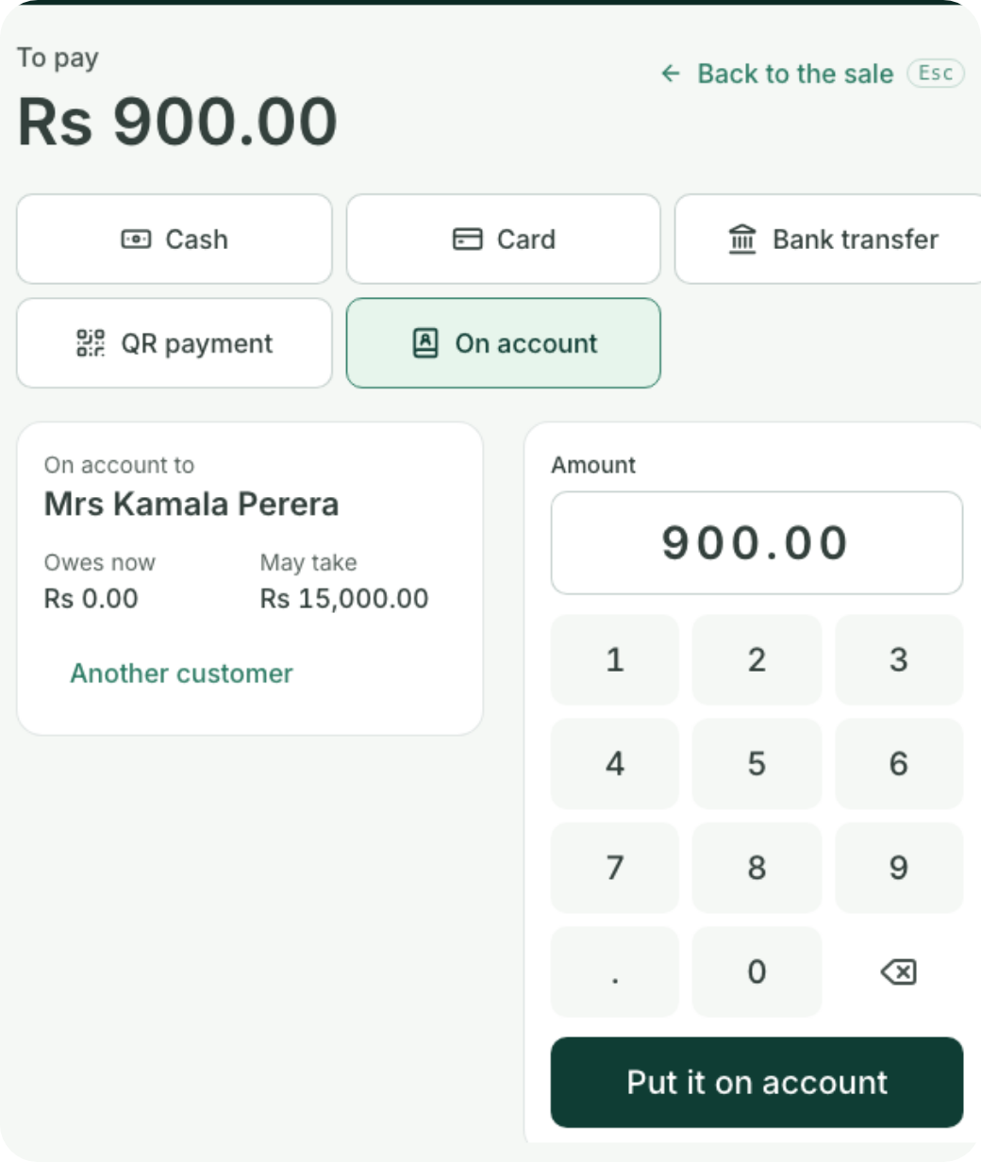
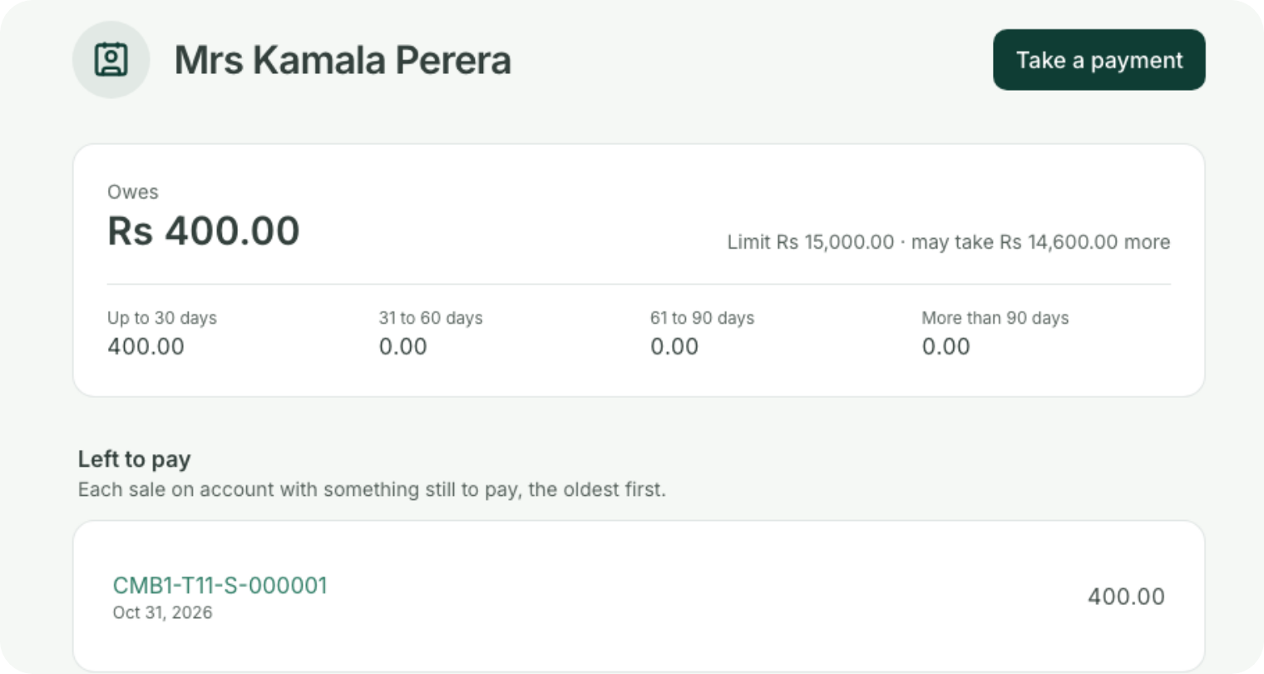

CUSTOMERS ON CREDIT
Sell on credit, without the notebook.
A credit limit for each customer
The till knows what they may take,
offline too
Past the limit, a manager’s PIN
Who owes what, and for how long
Notes:
Many shops have customers who pay at the end of the month, written in a notebook at the counter. With Coredile, each customer has a credit limit. At the till, the cashier chooses “On account”, finds the customer, and sees how much they may still take, even with the internet down. Going past the limit needs a manager’s PIN. In the back office you see who owes what, and how long it has been owed: up to 30 days, 60, 90 or more. When they pay, you take the payment at the till or in the office.

Slide 8
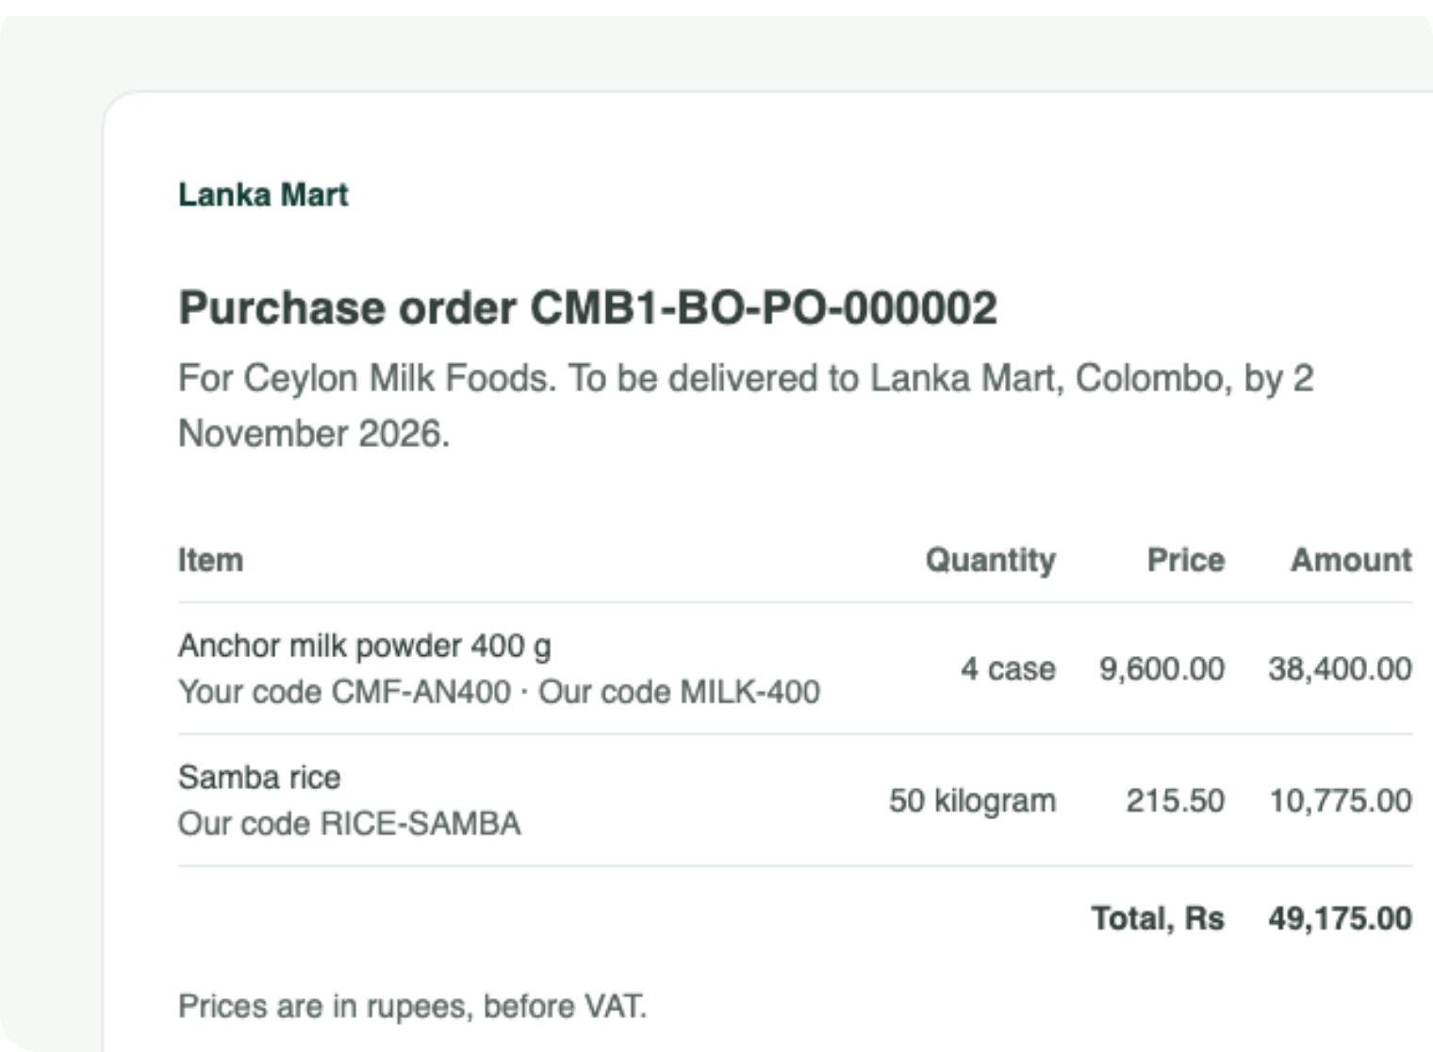

BUYING
Order from suppliers in minutes.
See what’s running low, by supplier
Email the order straight to the supplier
Receive what really came, at the delivery note’s price
Batch and expiry date kept for every delivery
Know what you owe each supplier
Notes:
Ordering is quick. You set a reorder level for each item, and Coredile lists what’s running low, grouped by supplier, with how many to order. The order goes straight to the supplier by email, like this one to Ceylon Milk Foods. When the delivery comes, you receive what actually arrived, at the price on the delivery note, with each batch’s expiry date. And the accounts always show what you owe each supplier.

Slide 9
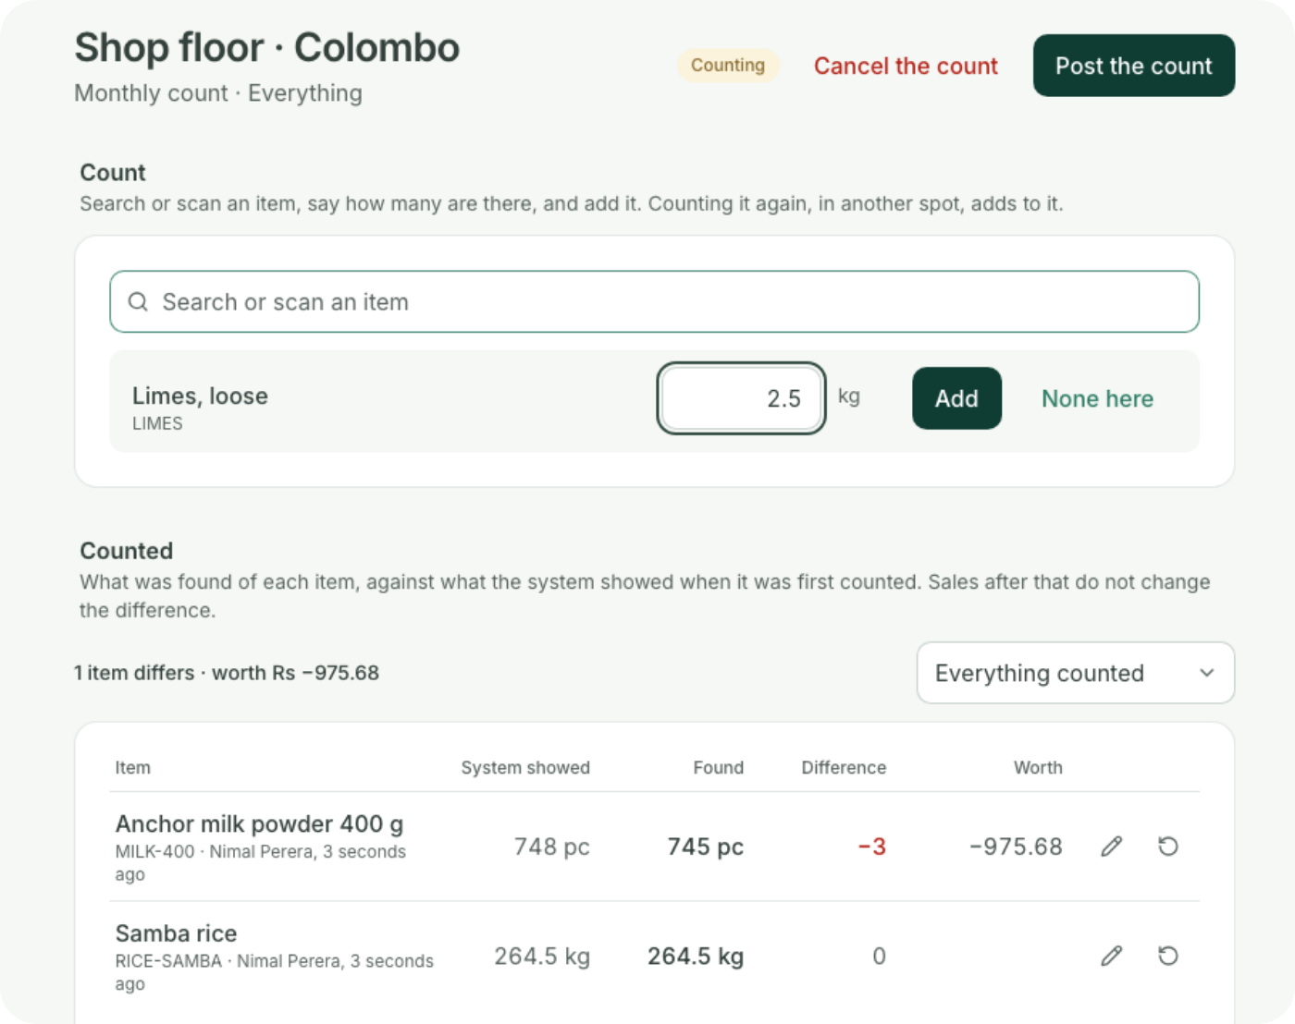
STOCK
Always know what’s on the shelf.
Every sale takes items off the stock
Count with several people at once, by scanning
See what went missing, in rupees
Move stock from one branch to another
Write off what’s damaged or expired
Notes:
No more counting everything by hand on a Sunday. Every sale takes the items off the stock by itself. When you do count, several people can count at once, scanning each item, and they don’t see what the system expects, so they count what’s really there. Coredile then shows what went missing, in rupees: here, three tins of milk powder, worth Rs 975. If you have more than one branch, you can move stock between them. And what’s damaged or expired is written off with a reason.

Slide 10
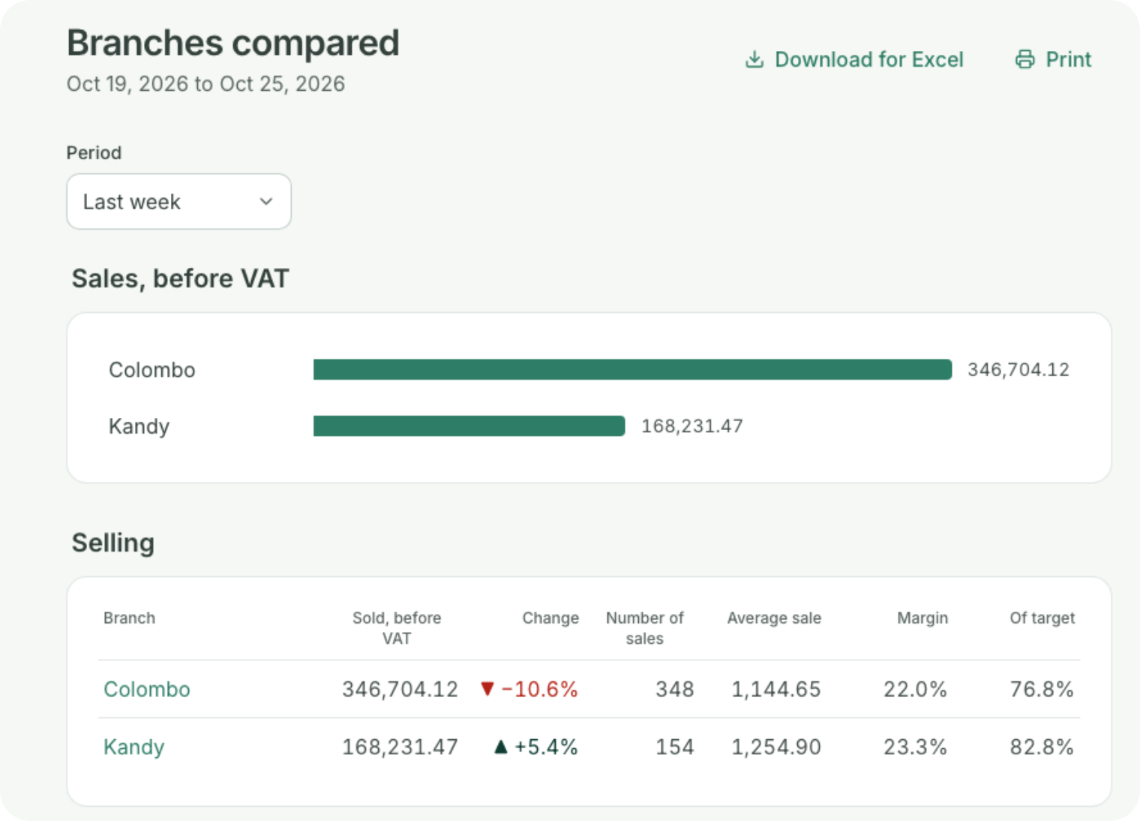





FOR THE OWNER
See every branch from your phone.
Today against last week, hour by hour
Each branch against its monthly target
What went missing, and what isn’t selling
Big refunds, write-offs and orders wait for your OK
One email at 7 a.m. with yesterday’s figures
Notes:
The owner does not need to be in the shop to know what’s happening. Home shows today’s sales against the same day last week, hour by hour, and each branch against its target for the month. Branches compared puts them side by side: sales, margin, what went missing and how many days of stock each has. Reports show what isn’t selling, so you stop buying it. Big refunds, write-offs and orders to suppliers wait for your approval, by how much they’re worth. And every morning at 7, an email arrives with yesterday’s figures.

Slide 11


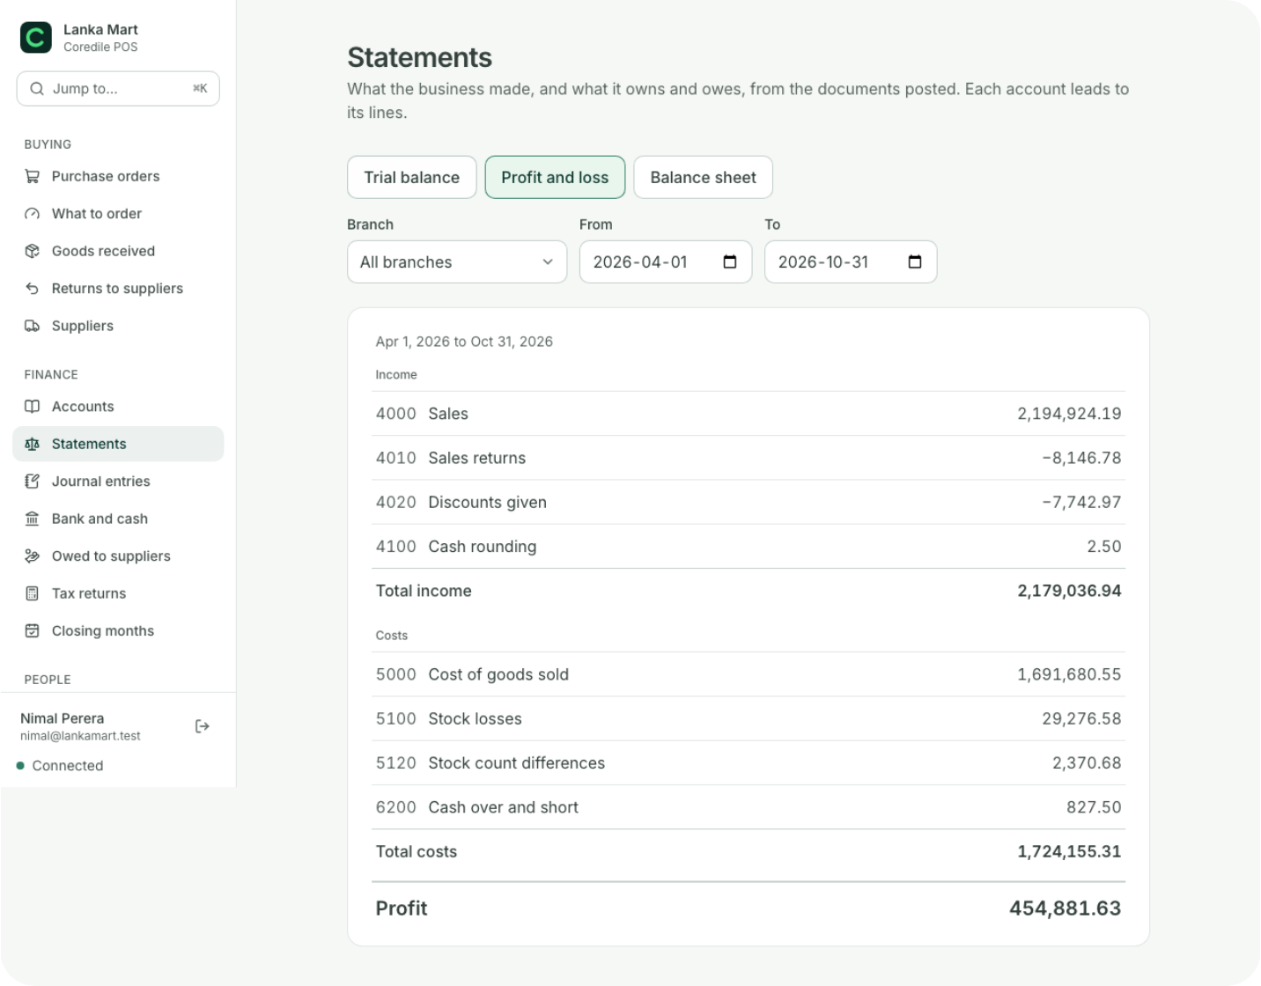


ACCOUNTS
Clean books for your accountant.
Profit and loss, for any
month
What you owe each
supplier
What your customers
owe you
A VAT and SSCL
summary each month
Every bill, delivery and refund writes itself into the books. Download any
report for Excel.
Notes:
No more bag of papers for the accountant at the end of the month. Every bill, every delivery from a supplier and every refund writes itself into the accounts as it happens. So at any time you can see your profit and loss, what you owe your suppliers, and what your customers owe you. Every month you also get a VAT and SSCL summary to give to your accountant. Any report can be downloaded for Excel.

Slide 12
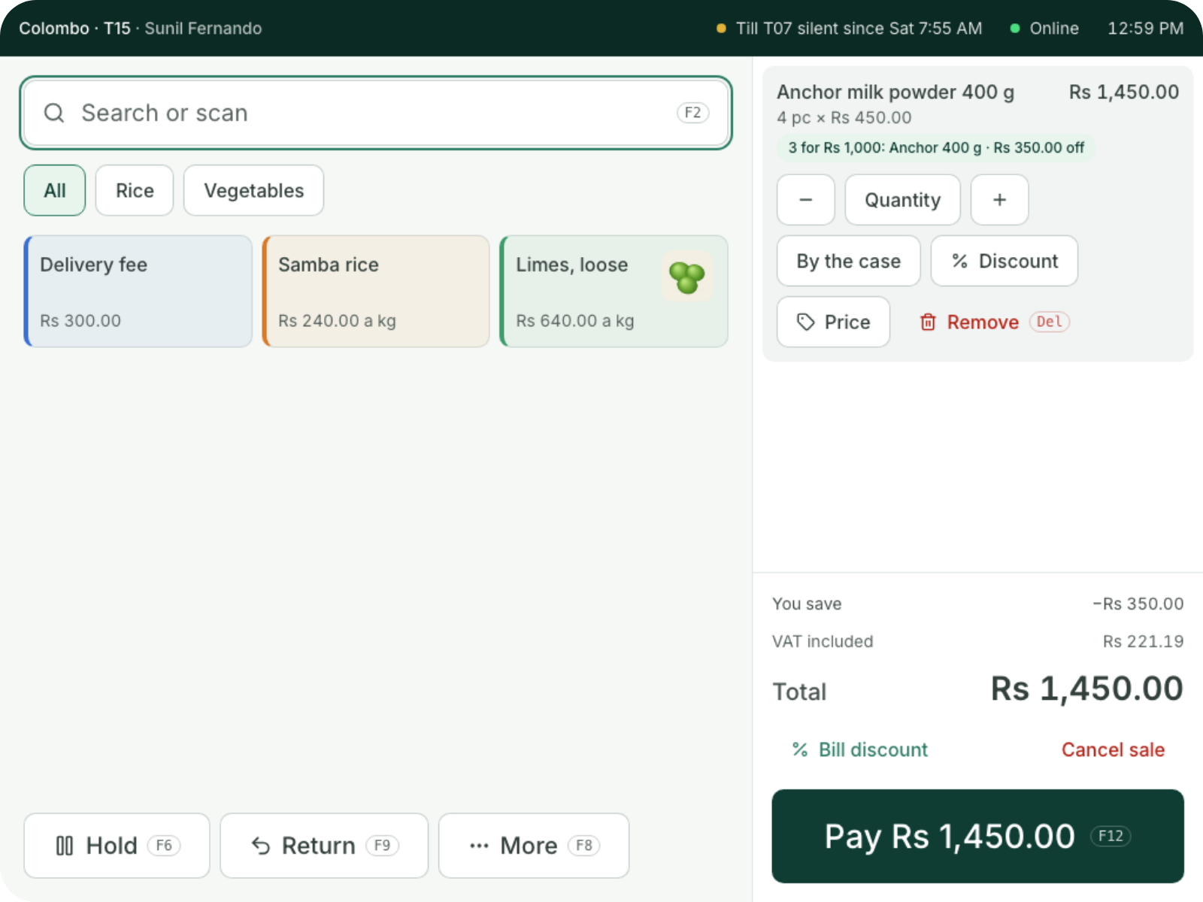
OFFERS AND LOYALTY
Deals that apply themselves.
3 for a price, buy 2 get 1, or money off a big bill
For some days, hours or branches
Members earn points and spend them
Gift cards, sold and spent at the till
The receipt shows what they saved
An add-on, if you want it: Rs 2,000 a month per branch.
Notes:
With Offers and Loyalty, you set up a deal once and every till applies it by itself: three for a price, buy two get one free, or money off a bill over a certain amount. Each deal can run on certain days, at certain hours, or in certain branches. Here, the till sees four tins of Anchor and takes off Rs 350 by itself, with nobody pressing anything. Members earn points and spend them, gift cards are sold and spent at the till, and the receipt shows the customer what they saved. Offers and Loyalty is an add-on, Rs 2,000 a month per branch, only if you want it.

Slide 13
WHAT CHANGES
Your day, before and after.
Without Coredile
With Coredile
Stock
Counted by hand on Sundays
Goes down with every bill
Reordering
When the shelf is empty
A list of what’s running low
Customer credit
A notebook at the counter
Limits, balances and payments
Printed prices
The cashier guesses
The till asks
Internet down
Billing stops
Billing carries on
The owner
Phones each branch
Gets one email at 7 a.m.
Notes:
Here is the simple picture. Without Coredile, stock is counted by hand, you reorder when the shelf is already empty, customer credit lives in a notebook, the cashier guesses which printed price to charge, billing stops when the internet goes down, and the owner has to phone each branch. With Coredile, all of that happens by itself while you sell. You save hours every week, and you stop losing money you can’t see.

Slide 14
PRICE
One price per branch.
No charge per cashier, per product or per bill.
Shop
Extra till
Rs 1,500 a month
Rs 4,500
a month per branch, with two tills
Offers and Loyalty, if you want it
Rs 2,000 a month
Billing, barcodes and printed prices
Stock, counts and transfers
Suppliers and orders
Customers on credit
Pay yearly
Accounts and VAT summary
Every report and the dashboard
2 months free
Setup and training are agreed with you, in writing, before we start. Prices in Sri Lankan rupees; VAT is added if it applies.
Notes:
Our price is simple. A shop pays one price per branch, per month: Rs 4,500. That includes two tills, billing with barcodes and printed prices, stock, counts and transfers between branches, suppliers and orders, customers on credit, the accounts with the VAT summary, and every report and the dashboard. There is no extra charge for more cashiers, more products or more bills. If you need a third till, it is Rs 1,500 a month. Offers and Loyalty, for deals, points and gift cards, is Rs 2,000 a month per branch, only if you want it. If you pay for a year, you get 2 months free. Setup and training depend on your shop, and we agree that price with you in writing before anything starts.

Slide 15
WHAT YOU NEED
Simple to start.
You bring
We do
A Windows PC or laptop for each till
Bring in your products and stock from Excel
A receipt printer
Set up your tills, branches and prices
A barcode scanner and a cash drawer
Train your staff
Your product list in Excel, if you have one
Answer when you call us for help
No hardware yet? We’ll give you a price for all of it.
You check everything before you start selling.
Notes:
Getting started is easy. You need a Windows PC or laptop for each till, a receipt printer, and a barcode scanner and cash drawer. If you already have your products in an Excel sheet, bring it: Coredile brings products and their stock in from a spreadsheet in one go. If you don’t have the hardware yet, we can give you a price for all of it. We do the hard part: we bring in your products, set up your tills, branches and prices, and train your staff. And when you need help, you call us.

Slide 16

GETTING STARTED
Four simple steps.
1
2
3
4
Free demo
Agree the price
We set it up
Start selling
We show you Coredile working
with products like yours.
You get the setup and training
price in writing.
We load your products, set up
your tills and train your staff.
Pay by the month or by the
year.
No long contract. You pay month by month, or pay for 10 months and use it for 12.
Notes:
Here is how we start. First, a free demo, like today, with products like yours. Second, we agree the setup and training price, and you get it in writing. Third, we come and set everything up: we load your products, set up your tills and train your staff. Fourth, you start selling. There is no long contract. You pay month by month, or pay for a year and get 2 months free. The tills start billing once the first invoice is paid, and each invoice is emailed to you 10 days before it’s due.

Slide 17



WHO MAKES IT
Built in Sri Lanka,
by people you can call.
Your data is backed up every day
8
80+
No other business can ever see your data
Updates come to you, at no extra cost
years building software for
businesses
projects delivered
Help from the people who built it
Notes:
Coredile POS is made by Coredile, a Sri Lankan software company. We have spent 8 years building software for businesses, and delivered more than 80 projects. Your data is backed up every day, and no other business can ever see it. Updates come to you at no extra cost. And when you need help, you talk to the people who actually built the system, not a call centre.

Slide 18

NEXT STEP
Book your free demo.
We’ll show you Coredile with products like yours. Bring all your questions.
EMAIL
WEBSITE
WHATSAPP
hello@coredile.com
coredilepos.cloud
+94 72 282 2060
Notes:
Thank you. The best way to see if Coredile is right for you is a free demo with your own kind of products. We can do it at your shop, or here. Ask: when is a good day for you this week? Leave the contact details with them, and write down their business type and number of branches so the demo is ready for them.

